Slide 1






THANK YOU TO ALL THE SPONSORS
@Glob_AIBootcamp #GlobalAIBootcampBrisbane

Slide 2
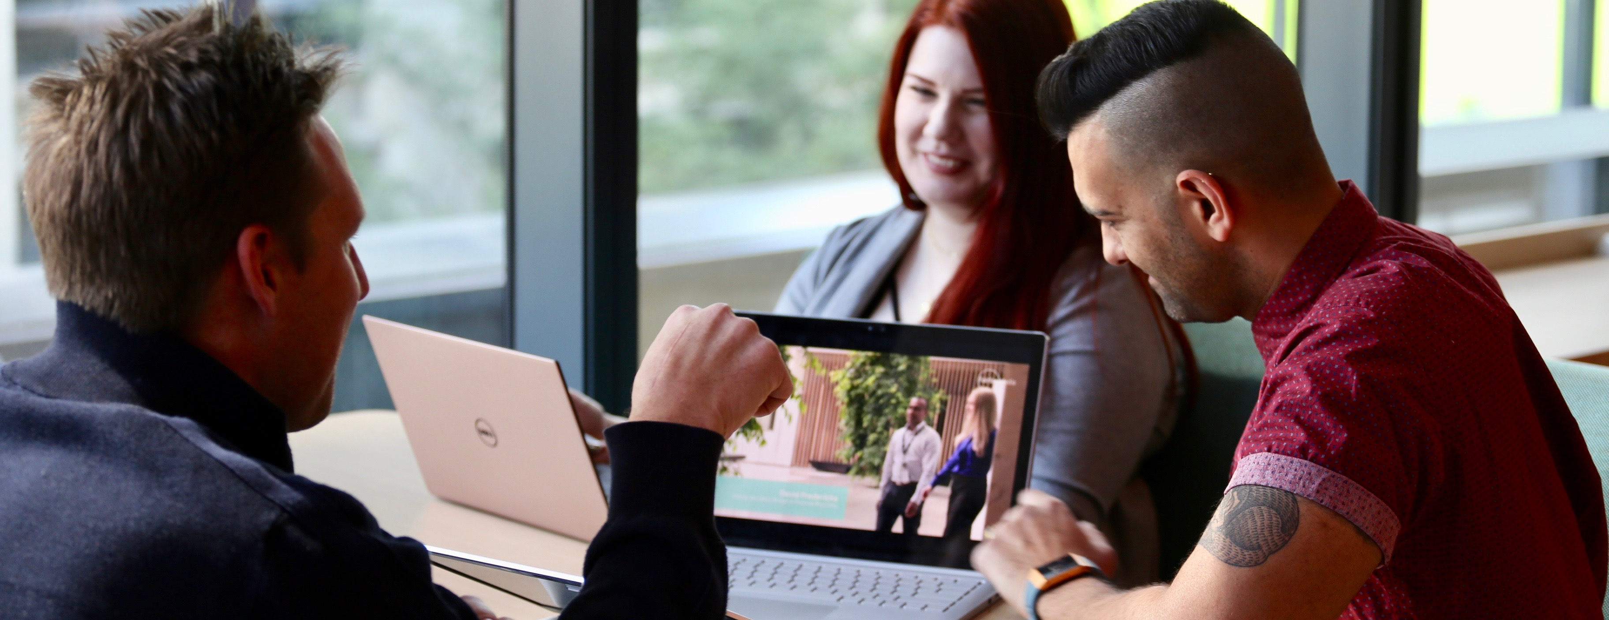
Azure machine learning done right!
15 Dec 2018 – Yousry Mohamed

Slide 3

Agenda
Some chit-chat
Demo: ML the DevOps way
Demo: Auto model selection
Demo: Consume ONNX models
Demo: Distributed deep learning training

Slide 4
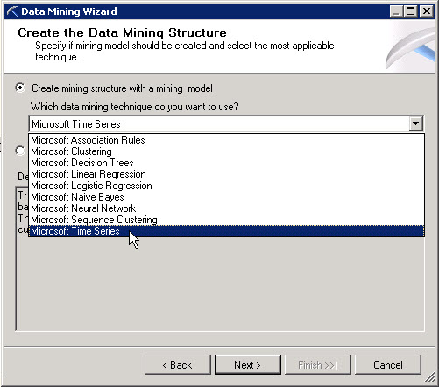
Origins of ML on Microsoft stack

Slide 5
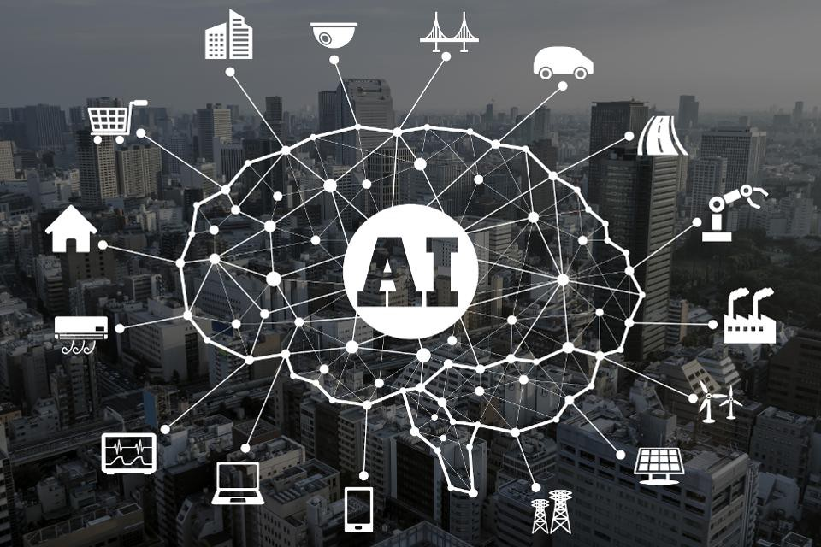
Notes:
We need to handle all funny things like
model versioning
deployment to edge devices,
big data , etc

Slide 6
Why another tool for ML?
 | ML Studio | ML Service
01 | Hard for DevOps | DevOps friendly
02 | Data size & compute limited | The limit is your Azure credit
03 | Deep Learning is hard | GPU/Distributed compute + DL libraries
04 | Blackbox components | BYO libraries/algorithms
05 |  | Edge deployment and inference, ONNX, etc

Slide 7
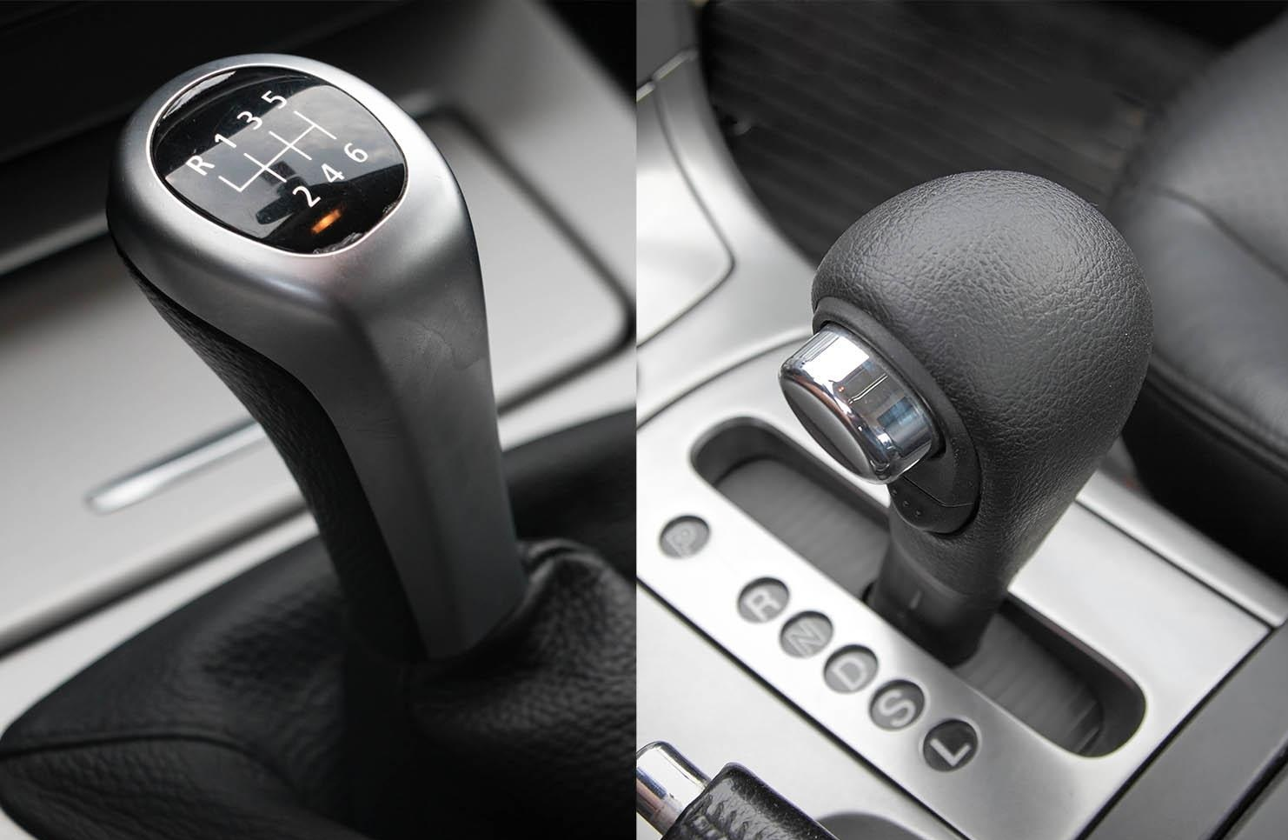
It’s about the right tool for the job

Slide 8


Slide 9
Setup & prerequisites
Azure account
Create ML Service workspace
Python & an IDE like VS Code or PyCharm
Install ML service SDK

Slide 10
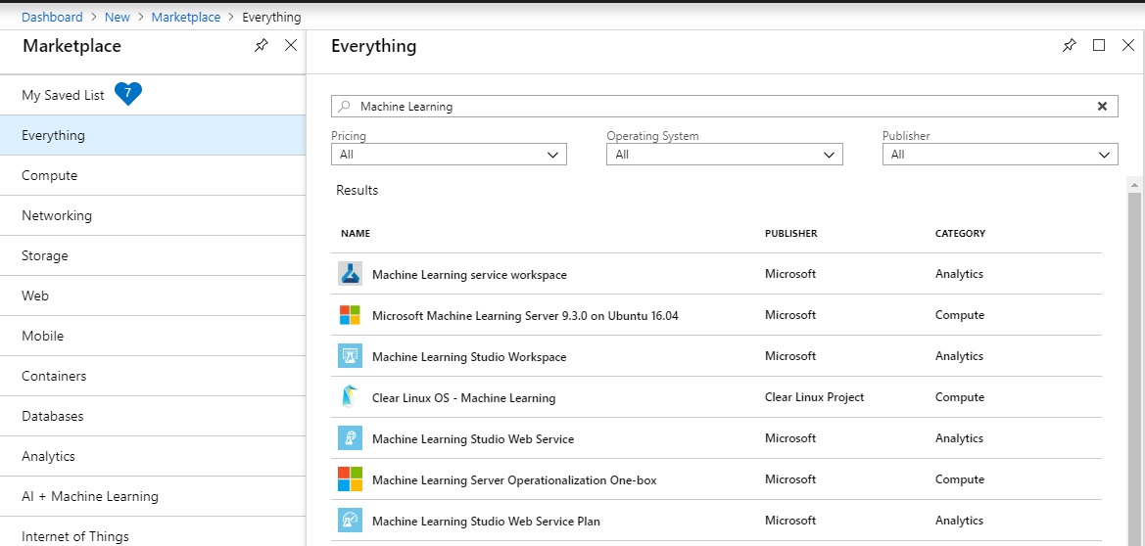
Create ML workspace

Slide 11
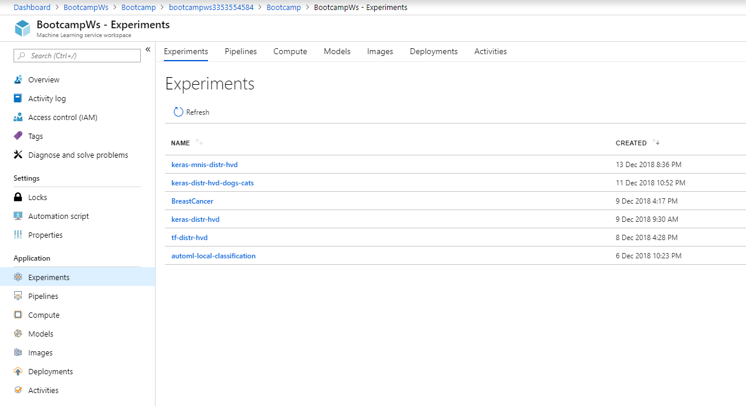
ML service workspace overview

Slide 12


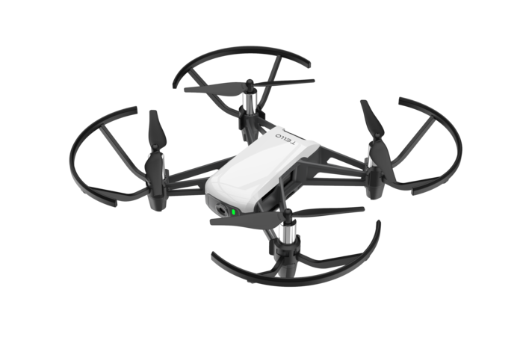

FEEDBACK AND PRIZES
feedback.brisbanebootcamp.com
@Glob_AIBootcamp #GlobalAIBootcampBrisbane

